Slide 1
Data Structures and Algorithms
INFO-3135
Linear Data Structures
Stack and Linked List

Slide 2
Dynamic array allocation
int myArray[3] = { 1, 2, 3 };
  Done at COMPILE tile (knows size, etc.)
  On the STACK
  Can’t resize it
  Limited in size (‘cause of the stack size)
  Disappears when it goes out of scope (i.e. we hit the “}”)
Notes:
https://www.geeksforgeeks.org/the-c-standard-template-library-stl/

Slide 3
Dynamic array allocation
int myArray[3] = { 1, 2, 3 }; // STACK based, compile
int* pMyArray = new int[10’000];
  Not initialized
  It on the HEAP (that is V. important)
  Allocated (done) at run-time (not compile time)
  No real limit the HEAP size
  “never” goes out of scope:
    pMyArray WILL go out of scope
    Data it points do never does
  Disappears when we call delete
Notes:
https://www.geeksforgeeks.org/the-c-standard-template-library-stl/

Slide 4
Dynamic array allocation
int* pX = new int();
delete pX;
int x = 9; int* pX = &x;
int* pMyArray = new int[10’000];
delete pMyArray; // AAACK!! NO!!!
delete [] pMyArray;
Notes:
https://www.geeksforgeeks.org/the-c-standard-template-library-stl/

Slide 5
Dynamic array allocation
malloc() basically new()
free() basically delete()
You don’t want to mix malloc/free and new/delete
new() calls malloc()
Notes:
https://www.geeksforgeeks.org/the-c-standard-template-library-stl/

Slide 6
Recall:
C++ Standard Template Library

Slide 7
C++ Standard Library
The Standard Template Library is part of the C++ Standard Library, not separate from it
The C++ Standard Library:
  Is a collection of classes and functions written in the core language
  Is made up of C++ library entities which are declared in one or more standard headers
  Includes over 50 library header files, including the Standard Template Library header files
Notes:
https://www.geeksforgeeks.org/the-c-standard-template-library-stl/

Slide 8
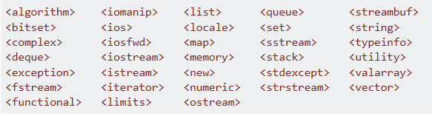

The C++ Standard Library
C++ Standard Library Header files
C Header files
Here is an up-to-date collection of C++ Libraries:
http://en.cppreference.com/w/cpp/header

Slide 9
What is the Standard Template Library?
The Standard Template Library was written by Alexander Stepanov and standardized by the ANSI/ISO committee in 1993
The Standard Template Library achieves its generic results using templates
This approach provides a compile-time overloading of data type resolution, rather than at runtime
For example:
vector<int> vec { 1,2,3 };
Notes:
https://www.geeksforgeeks.org/the-c-standard-template-library-stl/

Slide 10
Four Components of the STL
The Standard Template Library (STL) is made up of four components:
  Generic containers
  Iterators
  Generic algorithms
  Functors (function objects)
The Standard Template Library:
  Achieves generic containers using templates that can be used with any built-in type and with any user-defined type
  Provides iterators which can read from or write to containers
  Achieves generic algorithms using iterators
  Permits function objects to be invoked as arguments to algorithms
    e.g. predicates, built-in and user-defined function objects, lambda expressions
Notes:
https://www.geeksforgeeks.org/the-c-standard-template-library-stl/

Slide 11
Containers
STL includes libraries for data structures (called containers)
A container is a holder object that stores a collection of other objects of a similar type
Containers replicate structures very commonly used programming
Advantages of using STL container classes include:
  Use of a common interface
  A common set of operations
  Extensive use of iterators, which facilitate cycling through a container
  Use of generic algorithms

Slide 12
Types of Containers
Sequence
Sequence Adapters
Associative
Unordered Associative

Slide 13
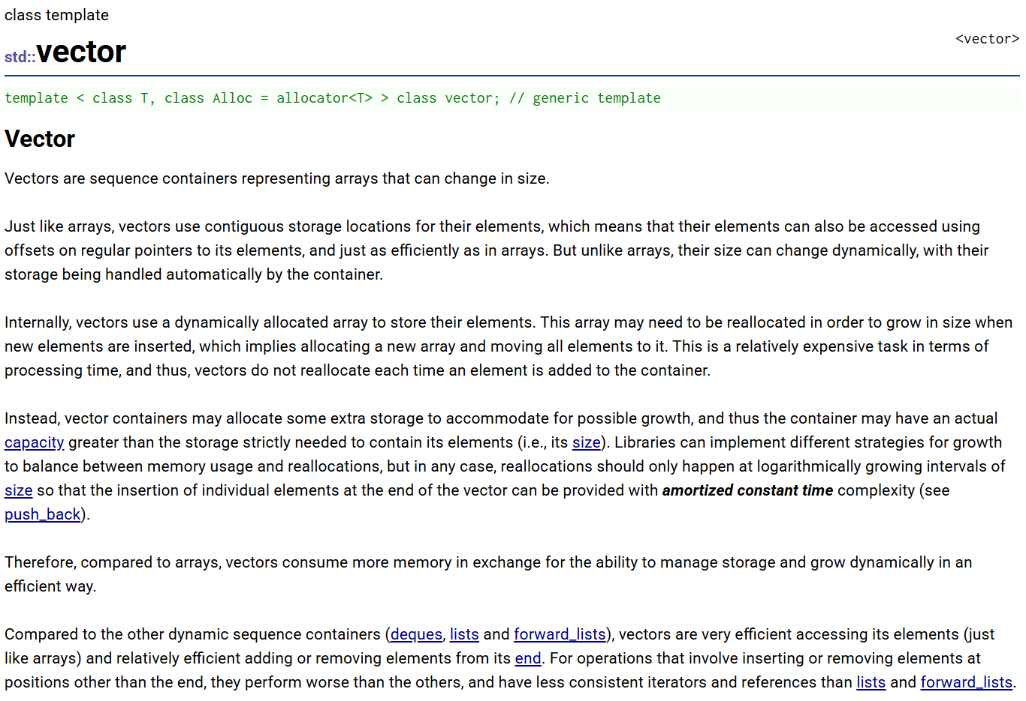
An STL Container - Vector
https://cplusplus.com/reference/vector/vector/
https://en.cppreference.com/w/cpp/container/vector.html

Slide 14
Introducing:
Containers or Collections

Slide 15
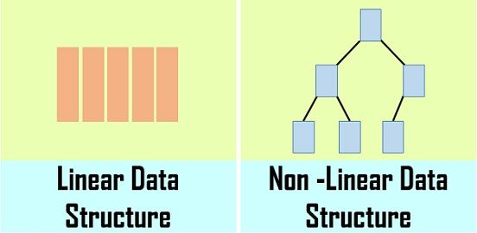
Containers or Collections
A container or collection gathers and organizes other objects, known as elements
The container defines specific ways in which its elements are managed and accessed
A user of the container must interact with the container only in the prescribed ways
There are two broad categories of containers:
Linear
  Elements are organized in a straight line
  Each element has a unique predecessor and successor
Nonlinear
  Elements are organized in a hierarchy or a network
  Each item may have only one predecessor but many successors

Slide 16
Two Categories of Collections
Linear Collections
Nonlinear Collections
Array
Vector
Stack
List
Queue
Tree
Binary tree
Binary search tree
Heap
Hashmap
Graph
Set
Map

Slide 17
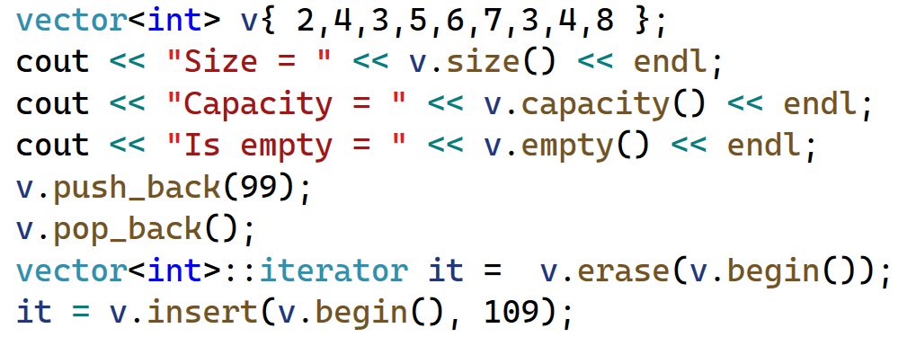
STL Containers
STL containers are collections of objects
They are Abstract Data Types that come with operations for accessing and managing the elements
All we must do is use them!
For example:
  Create a vector
  Get its size, capacity, empty state
  Add an element to the back
  Remove an element from the back
  Erase an element
  Insert an element
  Clear all elements

Slide 18

Abstract Data Type
An abstraction hides the details from its user
For example:
A driver of a car only needs to know operations like:
  Start
  Drive
  Reverse
  Brake
  Stop
A driver can use a car’s ignition, steering wheel, gas and brake pedals
  These can be described as the car’s interface
A driver doesn’t need to know anything about the mechanics or electronics of a car
  These can be described as the car’s implementation details

Slide 19
Why separate interface and implementation?
The interface defines the collection’s operations
  Keep code out of the interface definition (.h/.hpp) file unless it’s a template
A separate file implements the collection ‘s interface
Why?
  If you change the implementation of an operation, that is find a more efficient method, you don’t have to change the interface

Slide 20
Implementing our own Collections
Though the Standard Template Library comes with collections we can use, we will implement our own data structures

Slide 21
Collections have their own Operations
For each collection we will consider:
  how does collection operate conceptually
  how do we formally define the interface
  what kinds of problems does the collection help us solve
  in what ways will we implement the collection
  what are benefits and costs of each implementation

Slide 22
Linear Lists
Lists are one of the most common data structures for storing information
Lists are also referred to as collections
Examples of data we might store in a list:
  A list of game scores, or a player’s items that they have in their inventory
  A list of patients in a hospital who are waiting to been seen
Linear lists have sequential access
  Each element has a unique predecessor and successor
An array is a linear list.

Slide 23
An Array is a Linear List
An array stores its data in a straight line
  Array length = 9 elements
  First index = 0
  Last index = 8
An array uses contiguous memory and has random access to its elements
  array[6] = 77
Arrays are homogenous
Operations on arrays are limited to its structure
Arrays have a fixed size and capacity
array

Slide 24
Linear List Operations
Array
size
empty
front
back

Slide 25
A Vector is a Linear List
A vector stores its data in a straight line
  Vector size = 9 data elements
  Vector capacity = 9 memory allocation units
  First index = 0
  Last index = 8
A vector uses contiguous memory and has random access to its elements
  vector[6] = 77
vectors are homogenous
Operations on arrays are limited to its structure
A vector is dynamic and can be expanded or shrunk
  Vector size = 11 elements
  Vector capacity = 13 memory allocation units
vector
vector

Slide 26
Linear List Operations
Array
size
empty
front
back
[ ]
Vector
size
empty
front
back
[ ] or at
push_back
pop_back
clear
insert
erase

Slide 27
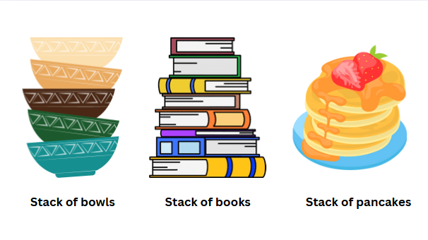
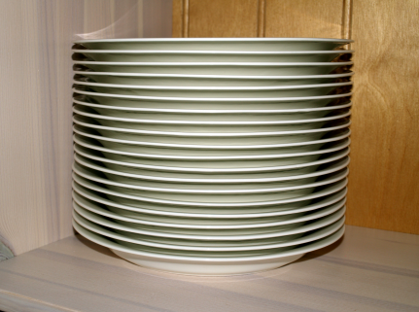
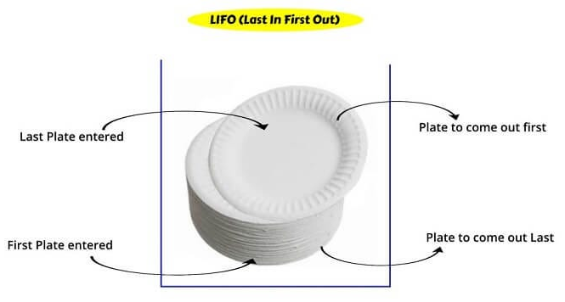
A Stack is a Linear List
A stack can be visualized by everyday objects
  A stack of bowls, books, or pancakes
  A stack of dishes in a cupboard
In all cases, the important characteristic is that the item on the top is the most easily accessed
  The top item can be removed
  A new item can be added to the top
Additionally:
  An item removed from a stack is the most-recently inserted item
A stack is a structure that uses the LIFO approach (Last in, First out)

Slide 28
Stack Operations
A stack is a structure that uses the LIFO approach (Last in, First out)
The stack data type is characterized by four operations:
  An “is empty” operation returns true if the stack contains no elements
  A new element can only be added “pushed” onto the “top” of the stack
  An element can only be removed “popped” from the “top” of the stack
  A “peek” operation gives access to the “top” without modifying the stack
We can also use an “is full” operation to check if the stack is full before we push a new value
  If the stack is full and does not contain enough space to accept a new value to be pushed onto the stack is then considered to be in an “overflow” state

Slide 29
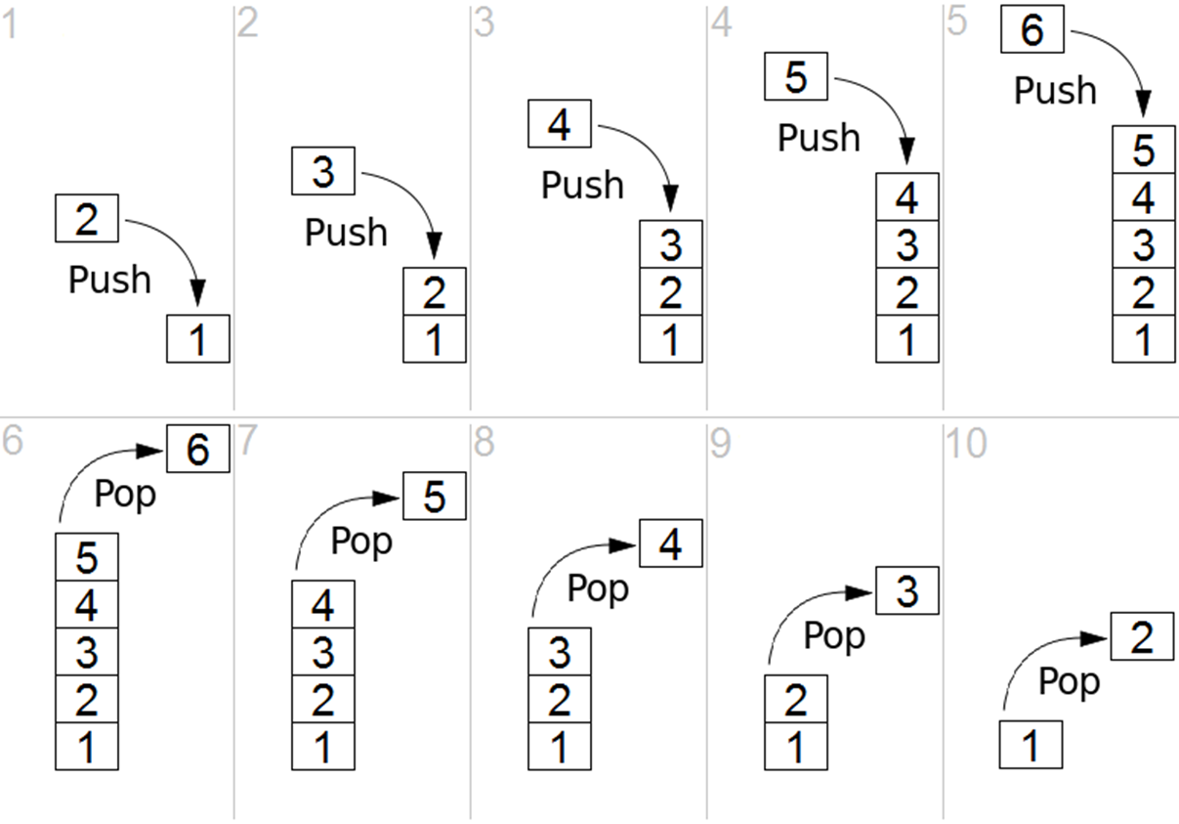
Stack Operations
Last In
LIFO
push() – add an element to the top of the stack
pop() – remove an element from the top of the stack
First Out

Slide 30
Linear List Operations
Array
size
empty
front
back
[ ]
Vector
size
empty
front
back
[ ] or at
push_back
pop_back
clear
insert
erase
Stack
size
empty
push
pop
peek

Slide 31
Uses of Stacks
Stacks have several different applications in software development and useful for any kind of problem involving LIFO data
For example:
  An "undo" mechanism in an application, where the last operation is “undone”, all changes are kept in a stack
  A compiler's syntax check for matching braces is implemented by using stack
  Call stack used by runtime system when methods are invoked
  The input stream data structure, both from keyboard and from file
  Back/Forward stacks on browsers
  Game development – “Backtracking” for example
    Find your way through a maze.
    Find a path from one point in a graph (roadmap) to another point.
    Play a game in which there are moves to be made (checkers, chess)

Slide 32
Stack as an Array
Using an array to implement a stack gives us a bounded array.
An array uses a defined size created in contiguous memory
We are constrained to the size (number of elements) of the array definition.
If we wish to have a different sized stack, we need to create another array that is larger (or smaller) and copy the contents over to the new array.
We can use dynamic arrays to provide this functionality

Slide 33
See demo:
Stack ADT with array implementation

Slide 34
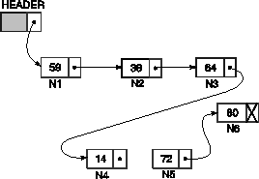
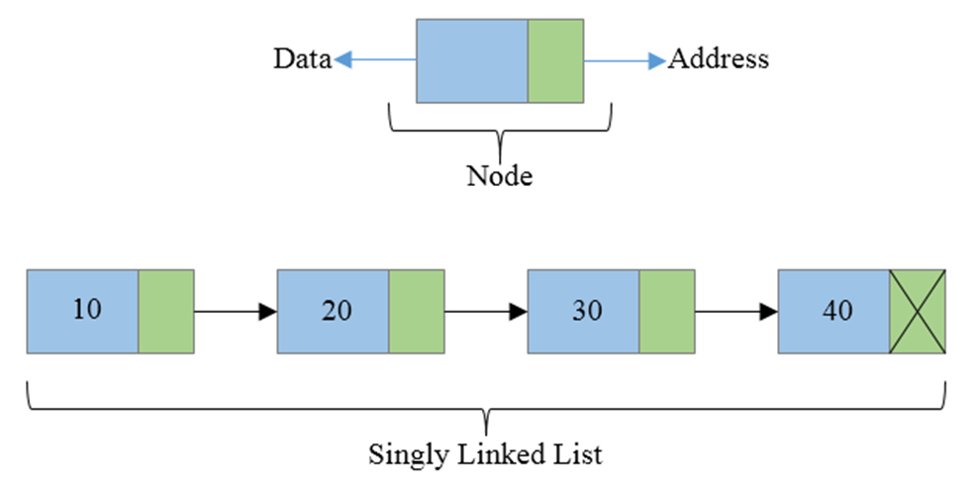
Linked List – an alternative implementation
Arrays are not the only way to implement lists
Linked List
A linked list maintains elements in a chain but not in contiguous memory
Each element is a “Node” containing a data value and a pointer
The pointer contains the address of the next link in the chain
A linked list is a collection of “nodes” that together form a linear ordering.
The first node of a linked list is called the head of the list
The last node in a singly linked list points to nothing

Slide 35
A Singly Linked List
A singly linked list can be traversed in one direction, from head to tail
Each “node” contains data which can be a primitive type or a derived type
Each node contains a pointer to the next node. If there is no next node the pointer is set to null
A node will be represented by a C++ class or struct.
Notes:
Moving from one node to another by following a next reference is known as link hopping or pointer hopping.

Slide 36
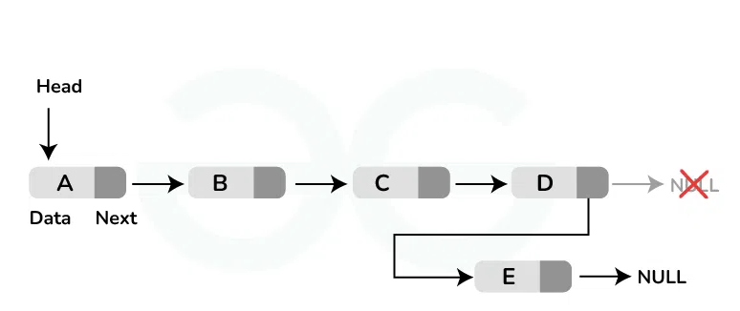
Linked List – adding a node to the end
void addToEnd(int value)
{
//1. create a new Node (value, nullptr)
Node* newNode = new Node(value);
//2.if list is empty, add new Node at head
if (head == nullptr)
{
head = newNode;
return;
}
//3. if list not empty, add new Node at end Node* current = head;
while (current->next != nullptr)
current = current->next;
current->next = newNode;
}

Slide 37
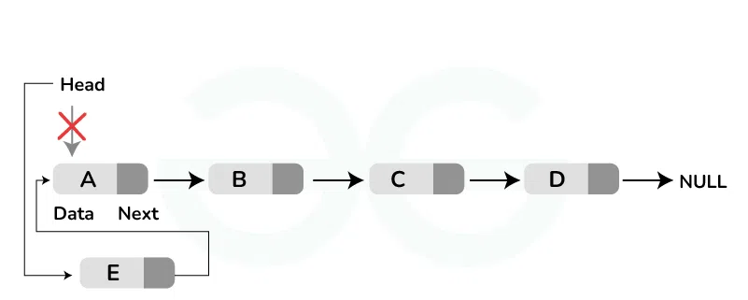
Linked List – adding a node to the front
void addToFront(int value)
{
Node* newNode = new Node(value);
newNode->next = head;
head = newNode;
}

Slide 38
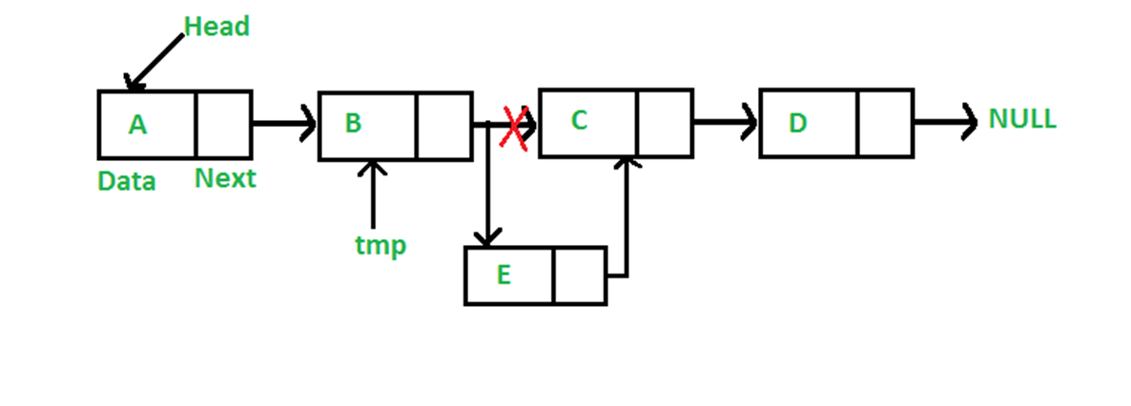
Linked List – adding a node to the middle
void addToMiddle(int location, int value)
{
Node* newNode = new Node(value);
Node* current = head;
for (int i = 0; i < location; ++i)
current = current->next;
newNode->next = current->next;
current->next = newNode;
}

Slide 39
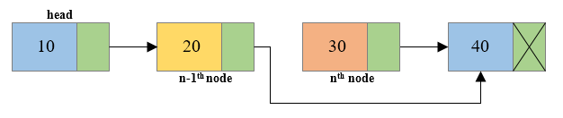
How do we find the previous node?
Exercise
We have a singly linked list and we want to delete from somewhere in the middle
We have a pointer to the one we wish to delete
We need to find the previous node.
Write the pseudo code

Slide 40
Let’s Define a Singly Linked List
Let’s write the pseudo code together first.
Describe the structure
  The linked list class
  The node
Describe the operations
  Add node
  Delete node from end
  Delete node from middle
  Traverse the list
There are other operations, but we will leave those for now

Slide 41
See demo:
Linked List with Node implementation

